Slide 1
Graph Algorithm

Slide 2
Graph Analytics
“ Graphs can be defined as a representation of relationships between “entities” (also known as nodes or vertices) of the graph and the relationships between them are represented by “links” (also known as “edges”) of the graph.”

Slide 3
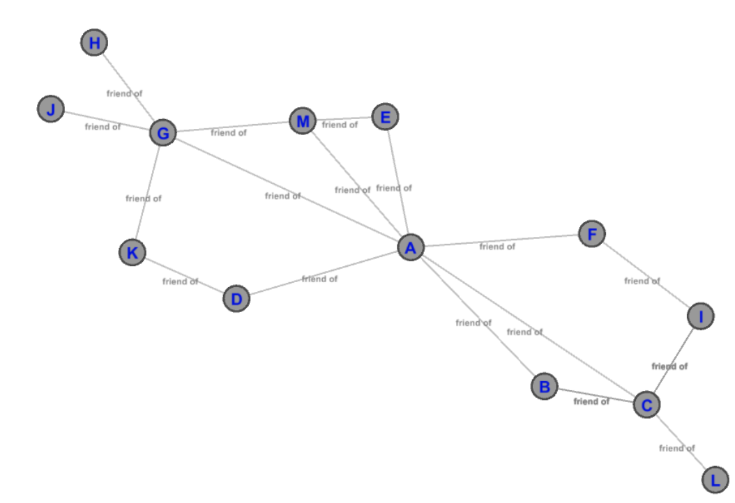
A graph of friends where the node/entity such as A,B etc. depicts a particular individual and a link (also known as an edge) between any two individuals depicts a relation (“friendship” in this case) between them.
By simply looking at the graph, one can analyze that A and B have a common friend C, which is not friends with D.

Slide 4
“ The branch of data science that deals with extracting information
from graphs by performing analysis on them is known as “Graph Analytics”.
Centrality
Centrality is a very important concept in identifying important nodes in a graph.
It is used to measure the importance of various nodes in a graph.
“centrality” is how “central” a node is in the graph
Each node could be important from an angle depending on how “importance” is defined.
Centrality comes in different flavors and each flavor or a metric defines importance of a node from a different perspective

Slide 5
Centrality
Tells us which nodes are important in a network based on the topological structure of the network (instead of just looking at the popularity of nodes)
– How influential a person is within a social network
– Which genes play a crucial role in regulating systems and processes
– Infrastructure networks: if the node is removed, it would critically impede (hinder or delay) the functioning of the network.

Slide 6
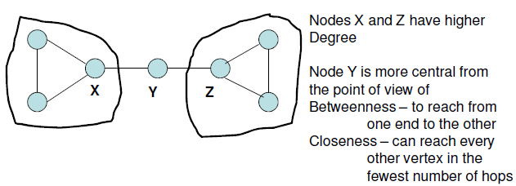
Centrality

Slide 7
Graph Analytics
A common goal in network analysis is to identify the “central" nodes of a network.
What does “central" mean?
active?
important?
non-redundant?
Koschutzki et al. (2005) attempted a classification of centrality measures
Reach: ability of vertex to reach other vertices
Flow: quantity/weight of walks passing through node
Vitality: effect of removing node from the network

Slide 8
Graph Analytics
We will define and compare four centrality measures (approaches):
degree centrality (based on degree)
closeness centrality (based on geodesic)
betweenness centrality
eigenvector centrality (recursive: similar to page rank methods)
In geometry, a geodesic is commonly a curve representing in some sense the shortest path between two points in a surface

Slide 9
Centrality Measures
Degree-based Centrality Measures
– Degree Centrality: measure of the number of vertices adjacent to a vertex (degree)
– Eigenvector Centrality: measure of the degree of the vertex as well as the degree of its neighbors

Slide 10
Centrality Measures
Shortest-path based Centrality Measures
– Betweeness Centrality: measure of the number of shortest paths a node is part of
– Closeness Centrality: measure of how close is a vertex to the other vertices [sum of the shortest path distances]

Slide 11
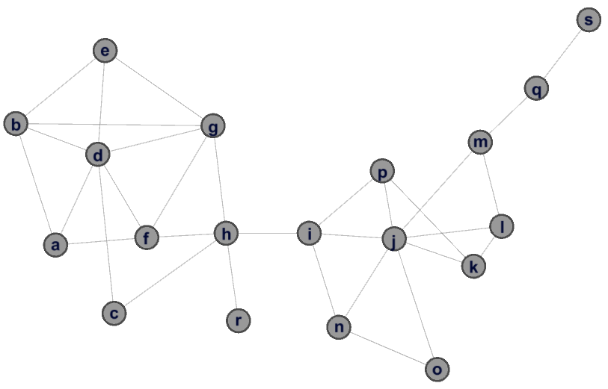
Different types of centralities:
Betweenness
Centrality
Closeness
Centrality
Eigenvector
Centrality
Degree
Centrality
Source: Discovering Sets of Key Players in Social Networks – Daniel Ortiz-Arroyo – Springer 2010/

Slide 12
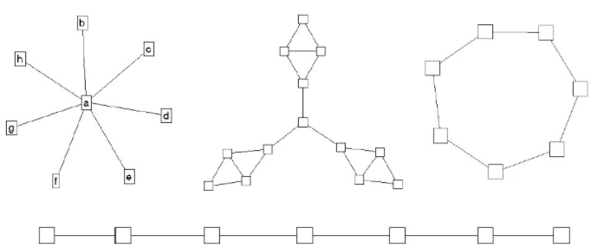
Centrality in Social Networks
Intuitively, we want a method that allows us to distinguish “important” actors.
Consider the following graphs:

Slide 13
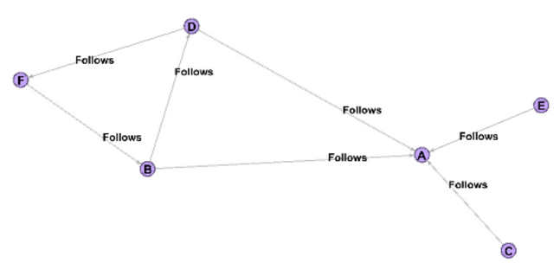
Degree Centrality
To understand it, let’s first revise the concept of degree of a node in a graph.
In a non-directed graph, degree of a node is defined as the number of direct connections a node has with other nodes.
In a directed graph, degree of a node is further divided into In-degree and Out-degree.
In-degree refers to the number of edges/connections incident on it
Out-degree refers to the number of edges/connections from it to other

Slide 14

Degree Centrality
“Degree Centrality metric defines importance of a node in a graph as being measured based on its degree i.e., the higher the degree of a node, the more important it is in a graph.”
Mathematically, Degree Centrality is defined as D(i) for a node “i” as below:

Slide 15
The degree centrality of node A is 7, node G is 5, node C is 4 and node L is 1.
This information is very useful for creating a marketing or an influencing strategy if a new product or idea/thought has to be introduced in the network. Marketers can focus on nodes such as A,G etc. with high degree centrality to market their product or ideas in the network to ensure higher reach-ability among nodes.

Slide 16
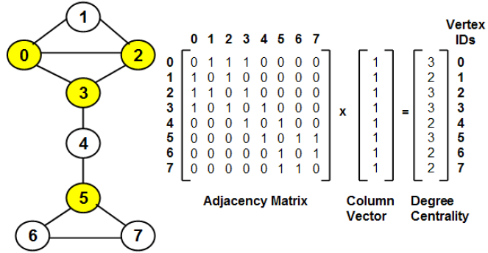
Degree Centrality
Weakness: Very likely that more than one vertex has the same degree and not possible to uniquely rank the vertices

Slide 17
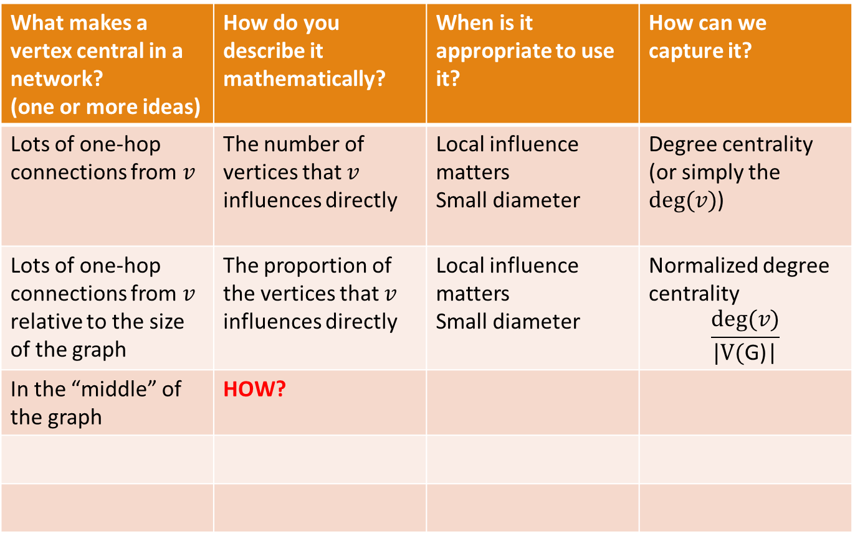
What makes a vertex central in a network? (one or more ideas) | How do you describe it mathematically? | When is it appropriate to use it? | How can we capture it?
Lots of one-hop connections from $v$ | The number of vertices that $v$ influences directly | Local influence matters Small diameter | Degree centrality (or simply the $deg⁡(v)$)
Lots of one-hop connections from $v$ relative to the size of the graph | The proportion of the vertices that $v$ influences directly | Local influence matters Small diameter | Normalized degree centrality $$\frac{deg⁡(v)}{\text{|}\text{V}\text{(}\text{G}\text{)|}}$$
In the “middle” of the graph | HOW?

Slide 18

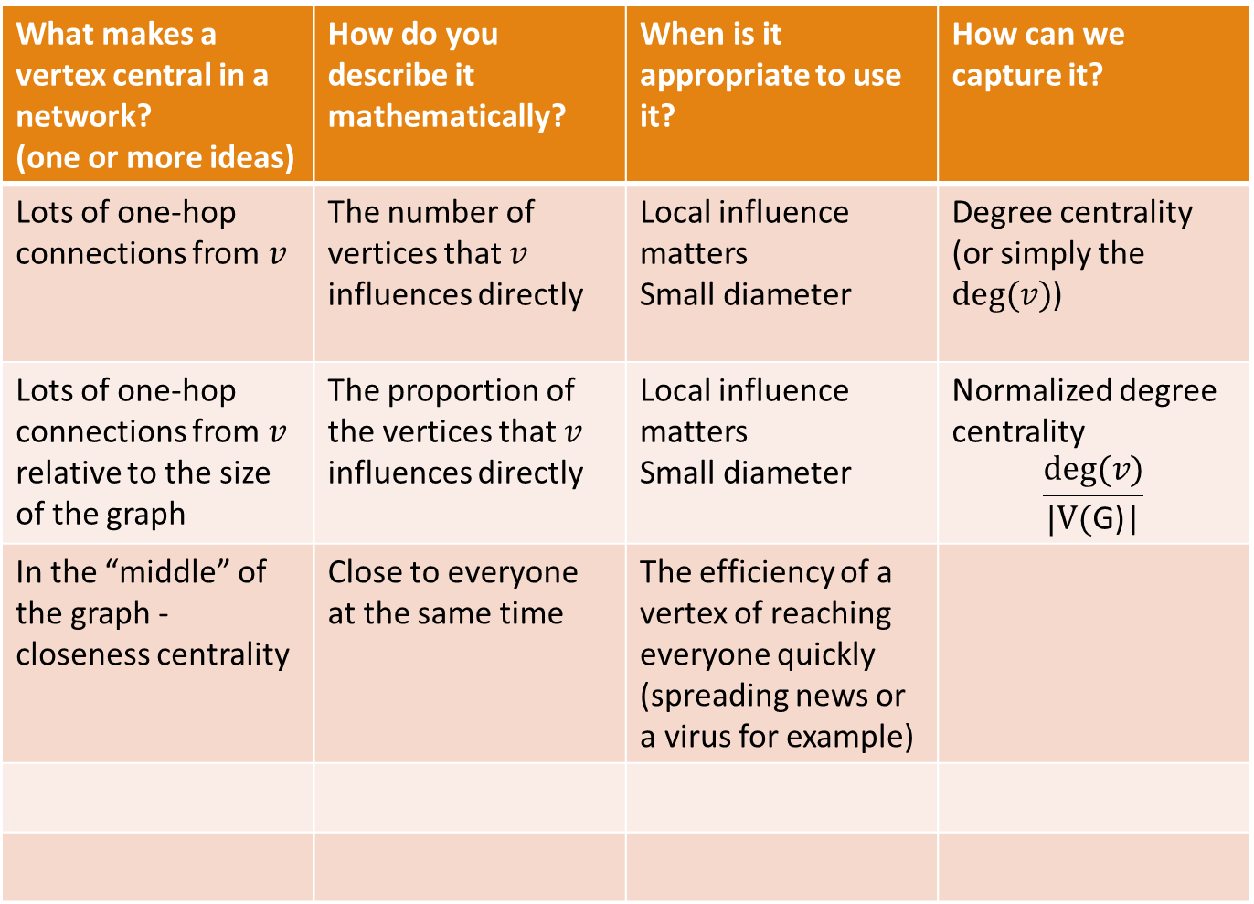
What makes a vertex central in a network? (one or more ideas) | How do you describe it mathematically? | When is it appropriate to use it? | How can we capture it?
Lots of one-hop connections from $v$ | The number of vertices that $v$ influences directly | Local influence matters Small diameter | Degree centrality (or simply the $deg⁡(v)$)
Lots of one-hop connections from $v$ relative to the size of the graph | The proportion of the vertices that $v$ influences directly | Local influence matters Small diameter | Normalized degree centrality $$\frac{deg⁡(v)}{\text{|}\text{V}\text{(}\text{G}\text{)|}}$$
In the “middle” of the graph - closeness centrality | Close to everyone at the same time | The efficiency of a vertex of reaching everyone quickly (spreading news or a virus for example)
$$C_{i}=1/{\sum_{j=1}^{n}{d(i,j)}}$$

Slide 19
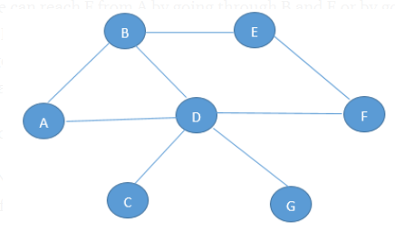
Closeness Centrality
“Geodesic distance” between two nodes in a graph.
The Geodesic distance d between two nodes a and b is defined as the number of edges/links between these two nodes on the shortest path(path with minimum number of edges) between them.
Examine the geodesic distance between A and F
Can reach F from A by going through B and E
Can reach F from A by going through B and D
Can reach F from A by going through B, D and E
By going through D.
The shortest path from F to A is through D (2 edges), hence the geodesic distance d(A,F) will be defined as 2 as there are 2 edges between A and F.

Slide 20
Closeness Centrality
Mathematically, Geodesic distance can be defined as below:
d(a , b) = No. of edges between a and b on the shortest path from a to b, if a path exists from a to b
d(a , b) = 0, if a = b
d(a , b) = ∞ (Infinity) , if no path exists from a to b
where, a = starting node, b = destination node

Slide 21


Closeness Centrality
“Closeness centrality defines the importance of a node
in a graph as being measured by how close it is to all other nodes
in the graph.”
For a node, it is defined as the sum of the geodesic distance between that node to all other nodes in the network.
Mathematically, Closeness Centrality C(i) of a node i in a graph can be defined as below:
$$C_{i}=1/{\sum_{j=1}^{n}{d(i,j)}}$$

Slide 22

Closeness Centrality
$$C_{i}=1/{\sum_{j=1}^{n}{d(i,j)}}$$
$$C_{A}=\frac{1}{d\left(AB\right)+d\left(AC\right)+d\left(AD\right)+d\left(AE\right)+d\left(AF\right)+d\left(AG\right)}$$
$$C_{A}=\frac{1}{1+1+1+2+1+2}$$
$$C_{A}=\frac{1}{8}=0.125$$

Slide 23
Closeness Centrality
What if it’s not so important to have many direct friends?
But one still wants to be in the “middle” of the network by being close to many friends.

Slide 24
Let’s suppose that in the friend’s graph, each link/edge had a weight (attribute) of 1 minute associated with it i.e., it would take 1 minute to transmit information from a node to its neighboring node such as A to B or B to C.
We want to send a piece of specific information (information will be different for each node) to each node of the graph and need to select a node in the graph that can transmit it quickly to all the nodes in the network.
Calculate the Closeness Centrality measure for all the nodes in the network.
If select node A, the information can reach all the nodes by traversing 17 edges (i.e., starting at A, information can be transmitted to all nodes in 17 minutes)
Node L, where it would take 33 minutes to transmit the information to all nodes.

Slide 25
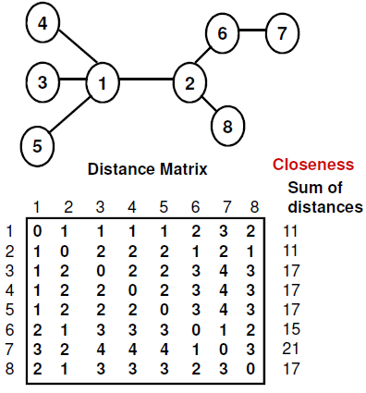
Closeness Centrality

Slide 26
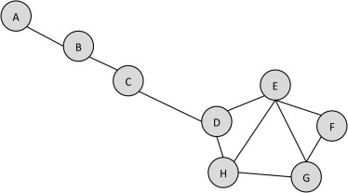
Closeness centrality
Closeness centrality indicates how close a node is to all other nodes in the network.
It is calculated as the sum of the shortest path length from the node to every other node in the network.
Consider Figure

Slide 27
Closeness centrality
Let’s start by computing the average shortest path length of node D. Following Table shows each node and the length of the shortest path from D.
The Shortest Path Lengths from D to each Other Node in the Network
Node Shortest Path from D
A 3 (D–C–B–A)
B 2
C 1
E 1
F 2
G 2
H 1
Sum of shortest paths length form D = 12

Slide 28
Closeness centrality
Now repeat this for node A. This is shown in following Table.
The Shortest Path Length from node A to Every Other Node in the Network
Node Shortest Path from A
B 1
C 2
D 3
E 4
F 5
G 5
H 4
Here, the sum of shortest path length is = 24
node D is more central by this measure.

Slide 29

Normalized closeness centrality
$${C^{normalized}}_{i}=\frac{n−1}{\sum_{j=1}^{n}{d\left(i,j \right)}}$$
where n is number of vertices in the graph.

Slide 30
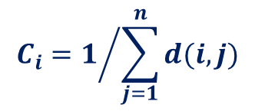
Closeness centrality - Limitations
In a typical network the closeness centrality might span a factor of five or less
It is difficult to distinguish between central and less central vertices
a small change in network might considerably affect the centrality order
Even small changes in the network can change the value substantially
What happens if the network is disconnected?
$$C_{i}=1/{\sum_{j=1}^{n}{d(i,j)}}$$

Slide 31
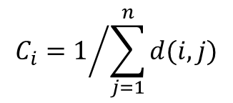
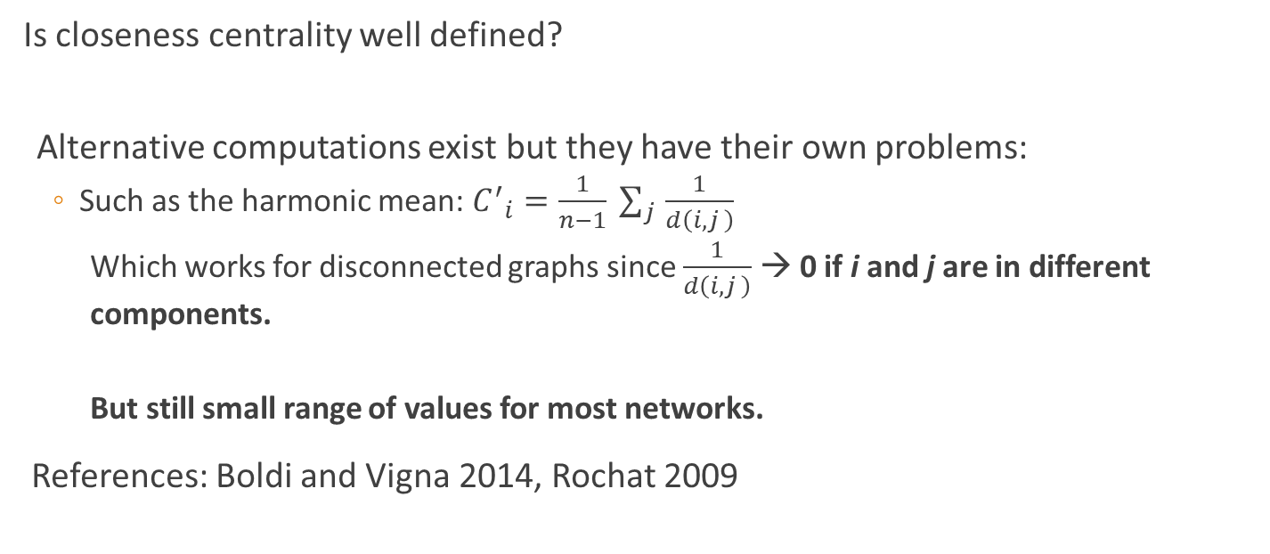
Harmonic (or closeness) centrality
$$C_{i}=1/{\sum_{j=1}^{n}{d(i,j)}}$$
Is closeness centrality well defined?
Alternative computations exist but they have their own problems:
Such as the harmonic mean: ${C^{′}}_{i}=\frac{1}{n−1} \sum_{j }{\frac{1}{d\left(i,j \right)}}$
Which works for disconnected graphs since $\frac{1}{d\left(i,j \right)}$ → 0 if i and j are in different components.
But still small range of values for most networks.
References: Boldi and Vigna 2014, Rochat 2009

Slide 32
Betweenness Centrality
A sample application of betweenness centrality is to find bridge nodes in graphs.
Nodes having high betweenness centrality are the nodes that are on the shortest paths between a large number of pair of nodes.
Nodes having high betweenness centrality are crucial to the communication in a graph as they connect a high number of nodes with each other.
Removing these nodes from the network would lead to huge disruption in the linkage or communication of the network.

Slide 33
Betweenness Centrality
We will now discuss how to find the total number of shortest paths between any two vertices j and k as well as to find out how many of these shortest paths go through a vertex i (j ≠ k ≠ i).
Use Breadth First Search (BFS) to find the shortest path tree from vertex j to every other vertex k
– Root vertex j is at level 0
– Vertices that are 1-hop away from j are at level 1; 2-hops away from j are at level 2, and so on.
– The number of shortest paths from j to a vertex k at level p is the sum of the number of shortest paths from j to the neighbors of k in the original graph that are at level p-1
– The number of shortest paths from j to k that go through vertex i is the maximum of the number of shortest paths from j to i and the number of shortest paths from k to i.

Slide 34
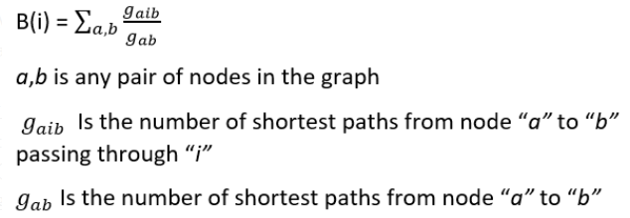
Betweenness Centrality
“Betweenness centrality measures the importance of a node in a network based upon how many times it occurs in the shortest path between all pairs of nodes in a graph.”
Mathematically, Betweenness Centrality B(i) of a node i in a graph can be defined as below:

Slide 35
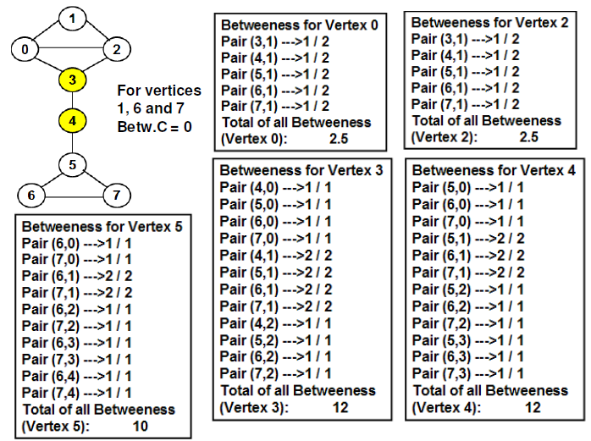
Betweenness Centrality

Slide 36
Node A, lies on the shortest path between the following pair of nodes :
(D,M), (D,E),(G,C),(G,B),(G,F),(G,I),(K,C),(D,C).
Nodes G and C also have high Betweenness Centralities (BCs) as compared to other nodes (except A) in the graph.
Node A has a very high Betweenness Centrality.

Slide 37
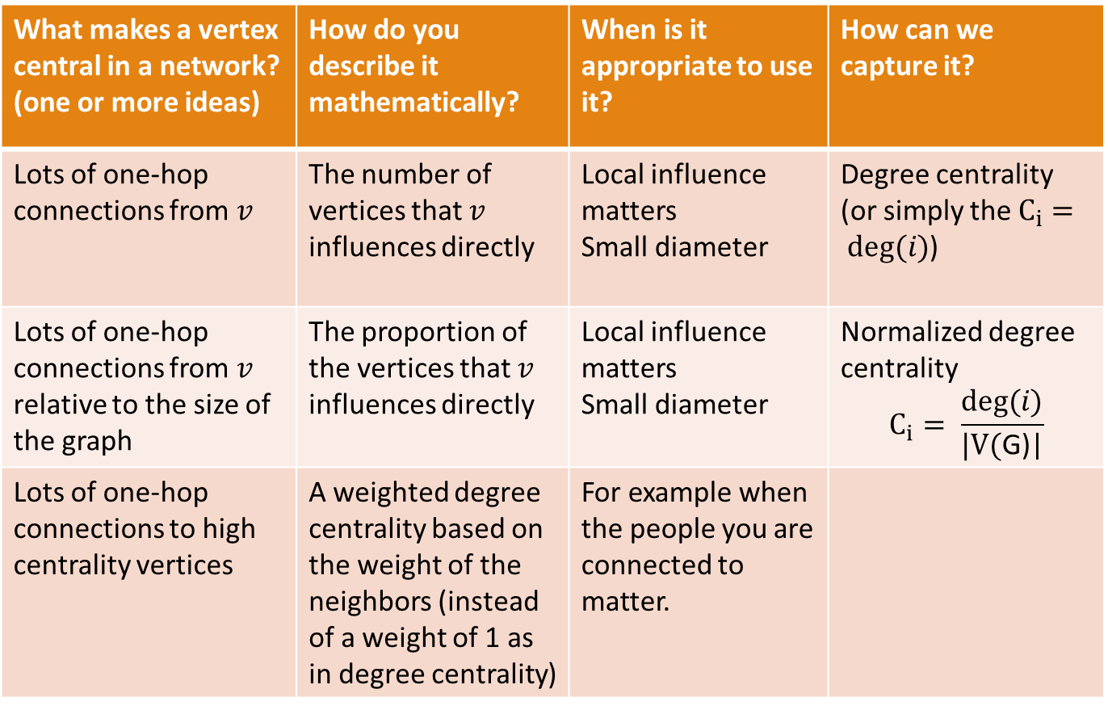
What makes a vertex central in a network? (one or more ideas) | How do you describe it mathematically? | When is it appropriate to use it? | How can we capture it?
Lots of one-hop connections from $v$ | The number of vertices that $v$ influences directly | Local influence matters Small diameter | Degree centrality (or simply the $C_{i}= deg⁡(i)$)
Lots of one-hop connections from $v$ relative to the size of the graph | The proportion of the vertices that $v$ influences directly | Local influence matters Small diameter | Normalized degree centrality $$C_{i}= \frac{deg⁡(i)}{\text{|}\text{V}\text{(}\text{G}\text{)|}}$$
Lots of one-hop connections to high centrality vertices | A weighted degree centrality based on the weight of the neighbors (instead of a weight of 1 as in degree centrality) | For example when the people you are connected to matter.

Slide 38
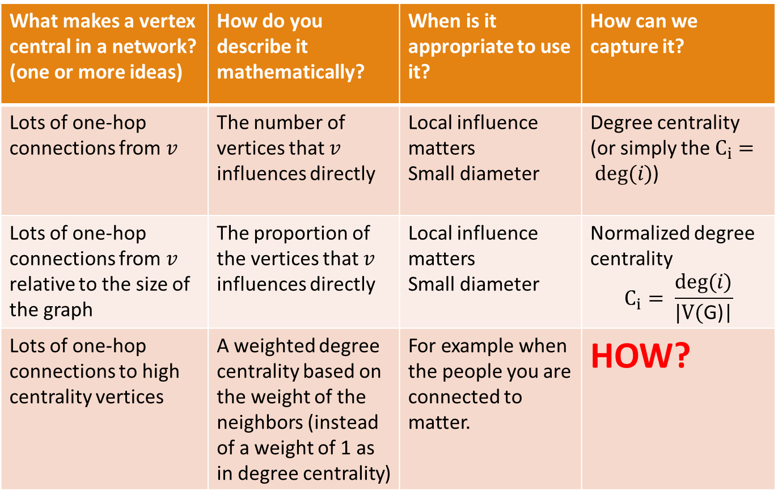
What makes a vertex central in a network? (one or more ideas) | How do you describe it mathematically? | When is it appropriate to use it? | How can we capture it?
Lots of one-hop connections from $v$ | The number of vertices that $v$ influences directly | Local influence matters Small diameter | Degree centrality (or simply the $C_{i}= deg⁡(i)$)
Lots of one-hop connections from $v$ relative to the size of the graph | The proportion of the vertices that $v$ influences directly | Local influence matters Small diameter | Normalized degree centrality $$C_{i}= \frac{deg⁡(i)}{\text{|}\text{V}\text{(}\text{G}\text{)|}}$$
Lots of one-hop connections to high centrality vertices | A weighted degree centrality based on the weight of the neighbors (instead of a weight of 1 as in degree centrality) | For example when the people you are connected to matter. | HOW?

Slide 39
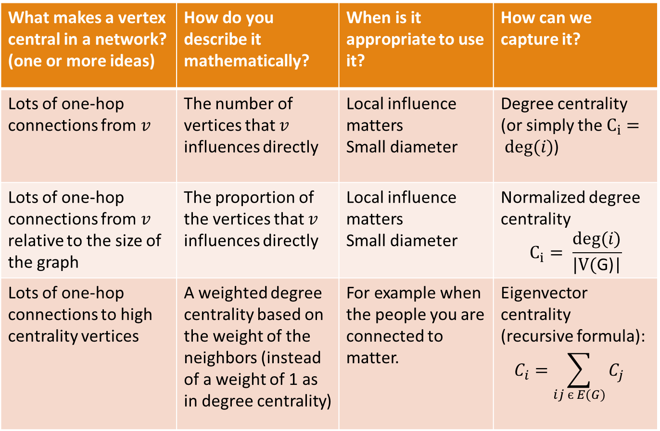
What makes a vertex central in a network? (one or more ideas) | How do you describe it mathematically? | When is it appropriate to use it? | How can we capture it?
Lots of one-hop connections from $v$ | The number of vertices that $v$ influences directly | Local influence matters Small diameter | Degree centrality (or simply the $C_{i}= deg⁡(i)$)
Lots of one-hop connections from $v$ relative to the size of the graph | The proportion of the vertices that $v$ influences directly | Local influence matters Small diameter | Normalized degree centrality $$C_{i}= \frac{deg⁡(i)}{\text{|}\text{V}\text{(}\text{G}\text{)|}}$$
Lots of one-hop connections to high centrality vertices | A weighted degree centrality based on the weight of the neighbors (instead of a weight of 1 as in degree centrality) | For example when the people you are connected to matter. | Eigenvector centrality (recursive formula): $$C_{i}={\sum_{ij є E(G)}{C_{j}}}_{}$$

Slide 40
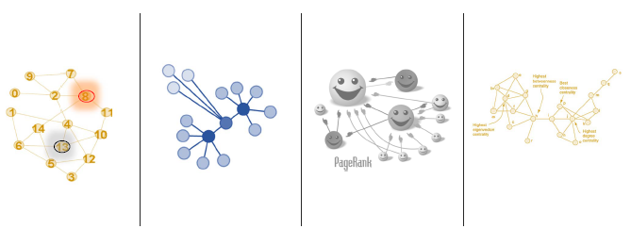
Eigenvector Centrality

Slide 41
Eigenvector Centrality
Eigenvector centrality is a measure of the influence a node has on a network.
If a node is pointed to by many nodes (which also have high eigenvector centrality) then that node will have high eigenvector centrality.
The earliest use of eigenvector centrality is by Edmund Landau in an 1895 paper on scoring chess tournaments.
More recently, researchers across many fields have analyzed applications, manifestations, and extensions of eigenvector centrality in a variety of domains:

Slide 42
Eigenvector Centrality
Eigenvector centrality is the unique measure satisfying certain natural axioms (statement which is self-evidently true) for a ranking system.
In neuroscience, the eigenvector centrality of a neuron in a model neural network has been found to correlate with its relative firing rate.
Eigenvector centrality and related concepts have been used to model opinion influence in sociology and economics, as in the DeGroot learning model.
The definition of eigenvector centrality has been extended to multiplex or multilayer networks.
Eigenvector centrality has been extensively applied to study economic outcomes, including cooperation in social networks. In economic public goods problems, a person's eigenvector centrality can be interpreted as how much that person's preferences influence an efficient social outcome.

Slide 43
Eigenvector Centrality
Eigenvector centrality is one of several node metrics that characterize the "global" (as opposed to "local") prominence of a vertex in a graph.
Others include Katz, Bonacich's power centrality, and Page Rank.
The gist of eigenvector centrality is to compute the centrality of a node as a function of the centralities of its neighbors.
A node is important if it is linked to by other important nodes.

Slide 44
Eigenvector Centrality
• Compute eigenvector centrality.
• Interpret the meaning of the values of eigenvector centrality.
• Explain why the eigenvector centrality is an extension of degree centrality.

Slide 45
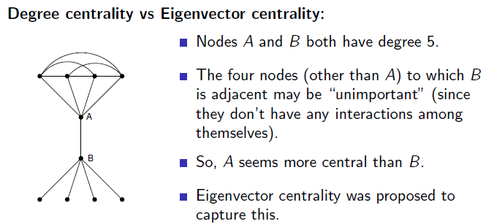
Eigenvector Centrality

Slide 46
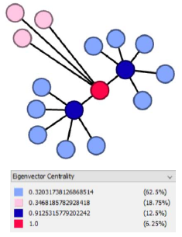
Eigenvector Centrality
A generalization of the degree centrality:
a weighted degree vector that depends on the centrality of its neighbors (rather than every
neighbor having a fixed centrality of 1)
• How do we find it? By finding the largest eigenvalue and its associated eigenvector (leading eigenvector) of the adjacency matrix
• Let’s see why

Slide 47
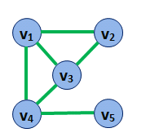
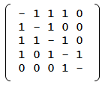
Eigenvector Centrality
What is an Eigenvector?
Consider the graph below and its 5x5 adjacency matrix, A.

Slide 48
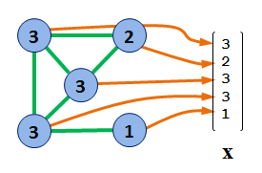
Eigenvector Centrality
And then consider, x, a 5x1 vector of values, one for each vertex in the graph. In this case, we've used the degree centrality of each vertex.

Slide 49
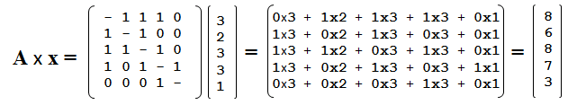
Eigenvector Centrality
Now let's look at what happens when we multiply the vector x by the matrix A. The result, of course, is another 5x1 vector.
If we look closely at the first element of the resulting vector we see that the 1s in the A matrix "pick up" the values of each vertex to which the first vertex is connected (in this case, the second, third, and fourth) and the resulting value is the sum of the values each of these vertices had.

Slide 50
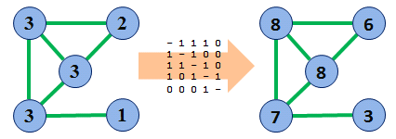
Eigenvector Centrality
In other words, what multiplication by the adjacency matrix does, is reassign each vertex the sum of the values of its neighbor vertices.

Slide 51
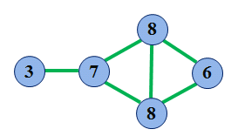
Eigenvector Centrality
This has, in effect, "spread out" the degree centrality. That this is moving in the direction of a reasonable metric for centrality can be seen better if we rearrange the graph a little bit:

Slide 52
Eigenvector Centrality
Figure out the adjacency matrix A for this graph.
Use the equation λ x = A x to determine the centrality scores for the nodes of this graph. (Hint: if you have a computer calculation system like Mathematica or a fancy enough calculator, you can use the computer to calculate the eigenvalues and eigenvectors of a matrix and save yourself some time.)
Do the centrality scores for the nodes accomplish our goal of giving more connected nodes higher scores?
Observation: λ is an eigenvalue of matrix A and x is the corresponding eigenvector.
Online Link to compute Eigenvalue and Eigenvector:
https://www.emathhelp.net/calculators/linear-algebra/eigenvalue-and-eigenvector-calculator/?i=%5B%5B1%2C2%5D%2C%5B0%2C3%5D%5D

Slide 53
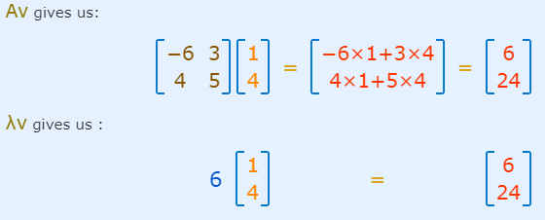
Eigenvector Centrality

Slide 54
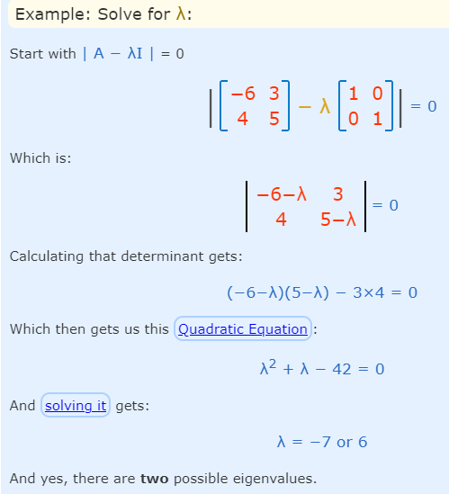


Eigenvector Centrality

Slide 55
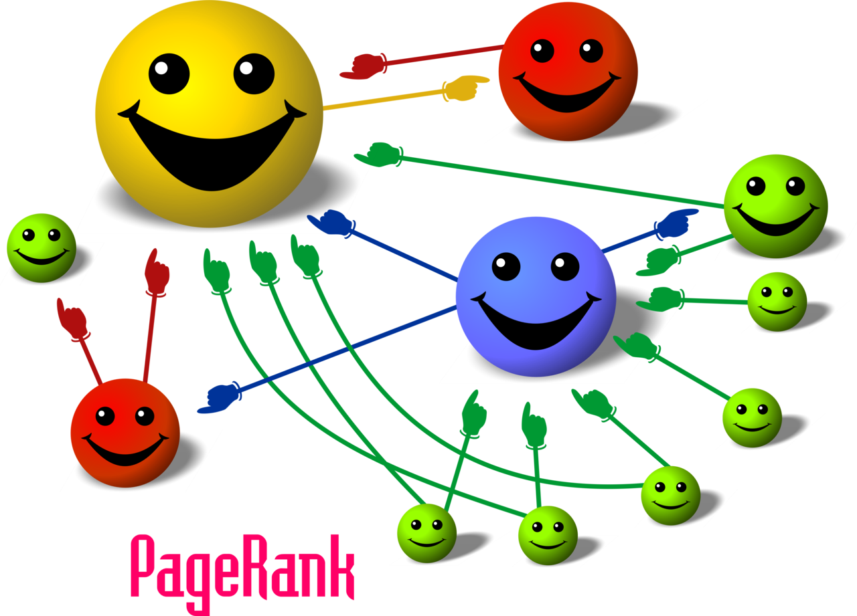
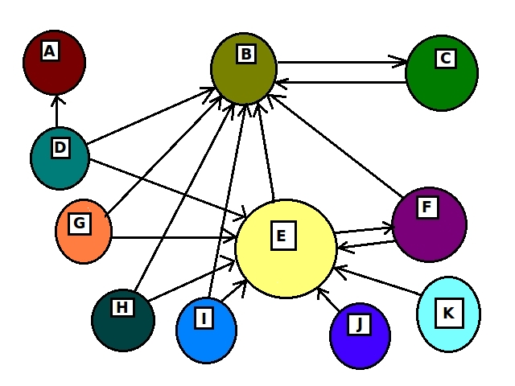
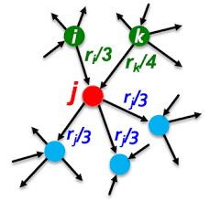
Page Rank

Slide 56
Page Rank
• Graph algorithms provide the means to understand, model and predict complicated dynamics such as the flow of resources or information, the pathways through which contagions or network failures spread, and the influences on and resiliency of groups.
• We begin our exploration of Centrality algorithms, with a look at PageRank, which estimates a current node’s importance from its linked neighbors and then again from their neighbors.
• One interesting bit of trivia about PageRank: It is named after Google cofounder Larry Page, and is used to rank websites in Google’s search results.

Slide 57
Page Rank
Page Rank is an algorithm that measures the transitive, or directional, influence of nodes.
All other centrality algorithms we discuss measure the direct influence of a node, whereas PageRank considers the influence of your neighbors and their neighbors.
For example, having a few influential friends could raise your PageRank more than just having a lot of low-influence friends.

Slide 58
When Should I Use PageRank?
Personalized PageRank is used by Twitter to present users with recommendations of other accounts that they may wish to follow.
The algorithm is run over a graph that contains shared interests and common connections.
PageRank has been used to rank public spaces or streets, predicting traffic flow and human movement in these areas.
The algorithm is run over a graph that contains intersections connected by roads, where the PageRank score reflects the tendency of people to park, or end their journey, on each street.
PageRank is also used as part of an anomaly or fraud detection system in the healthcare and insurance industries.
It helps find doctors or providers that are behaving in an unusual manner and then feeds the score into a machine learning algorithm.

Slide 59
Page Rank
Computed by either
iteratively distributing one node’s rank (originally based on degree) over its neighbors or
by randomly traversing the graph and counting the frequency of hitting each node during these walks.

Slide 60
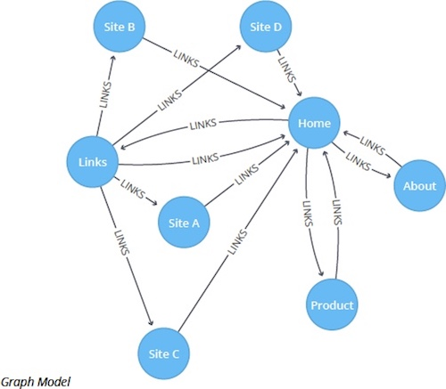
PageRank Example

Slide 61
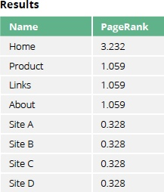
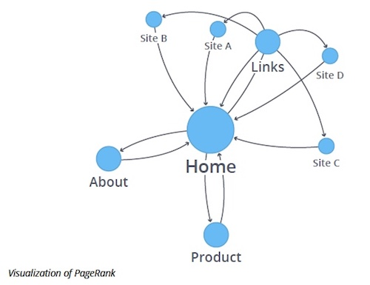
PageRank Example
Run the PageRank algorithm to calculate the most influential pages.

Slide 62
PageRank Example
As we might expect, the Home page has the highest PageRank because it has incoming links from all other pages. Also, it’s not only the number of incoming links that is important, but also the importance of the pages behind those links.

Slide 63
Page Rank
PageRank is used to estimate importance and influence.
To suggest Twitter accounts to follow and for general sentiment analysis.

